Slide 1



Slide 2



01CE0410 – Computer Network
Introduction of Computer Network
Prof. Megha Mudholkar
Department of Computer Engineering

Slide 3


Content
Understanding of Network & Internet
Data Communication
Categories of Network – Wired & Wireless
Types of Network – LAN, MAN, WAN, PAN
Transmission Modes
Understanding of Delay and its types
Network Topologies – Bus, Star, Ring, Mesh, Hybrid
OSI Model (Layered Approach)
TCP/IP Model
Switching Techniques: Circuit Switching & Packet Switching
Transmission Media

Slide 4
Course Outcome(CO)
CO1: Understand the basic terminologies used in networking, various networking topologies, switching techniques and layered architecture of computer network.

Slide 5

Understanding Network & Internet

Slide 6
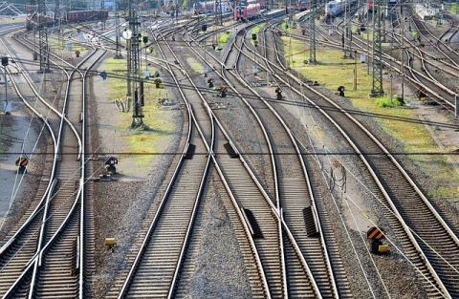
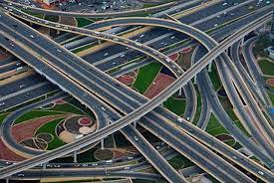
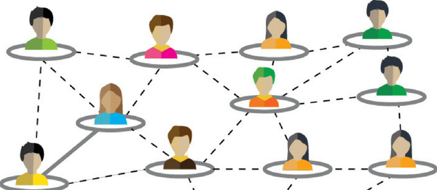
Understanding of Network & Internet
What is Network?
A group or system of interconnected people or things.
Example:
Group of People (Social media)
Railway tracks
Highways
Branch offices connected with Head Office
Src: https://ppp.worldbank.org/public-private-partnership/library/standard-railneteurope-contract-use-railway-infrastructure
Src: https://vajiramias.com/current-affairs/indias-road-network/5f5321b81d5def0d9a37598e/
Src: https://blog.thomasnet.com/grow-social-media-networks

Slide 7
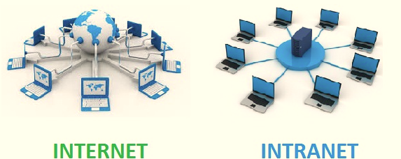
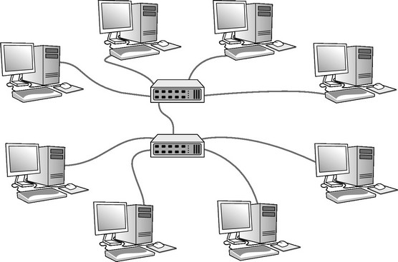
Understanding of Network & Internet
What is Computer Network?
Two or more computer systems connected with each other is known as computer network.
A computer network is a system that connects two or more computing devices for transmitting and sharing information.
Example:
Internet- a global network that connects millions of devices and computers worldwide.
Intranet- a private network that connects devices and computers within an organization.
Src: https://www.windowtonews.com/news.php?id=166594&cat_id=19

Slide 8
Understanding of Network & Internet
What is Internet?
The internet is a type of world-wide computer network.
Internet is a “network of networks”.
Internet is consist of academic, business and government networks, which carry various information and services.
It is global communication accessed through the web.
Internet deals with protocols and standards.
Example:
E-mail
Web access and services
file transfer

Slide 9
Understanding of Network & Internet
Protocols:
A protocol is a set of rules that governs data communications.
Protocol defines the method of communication, how to communicate, when to communicate etc.
Syntax: Syntax means format of data or the structure how it is pretend e.g. First eight bits for sender address, next eight bits for receiver address and rest of the bits for message/information.
Semantics: Semantics is the meaning of each section of bits e.g. The address bit means the route of transmission or final destination of the message.
Timing: Timing means, at what time data can be sent and how fast data can be sent.
1 | 1 | 0 | 0 | 1 | 1 | 0 | 1 | 0 | 1 | 1 | 0 | 1 | 1 | 1 | 0 | 1 | 1 | 1 | 0 | 0 | 0 | 1 | 0 | 1 | 1 | 1 | 1 | 0 | . | . | .

Slide 10
Understanding of Network & Internet
Standards:
Standards provide guidelines to the manufacturers, vendors, government agencies and service provider. It ensure that interconnectivity and compatibility of the device.
Standards help in maintaining market competitiveness and guarantees interoperability.
Data communication standards are of two categories: De facto and De jure
De facto: De facto means by facts or by convention. The standards that are not approved by any organization but are widely used are De facto standards. These are established by manufacturers.
De jure: De jure means by law or by regulation. These are the standards that are recognized officially by an organization.

Slide 11
Understanding of Network & Internet
What is Intranet:
An intranet is a kind of private network.
For example, an intranet is used by different organizations and only members/staff of that organization have access to this.
It is a system in which multiple computers of an organization (or the computers you want to connect) are connected through an intranet.
As this is a private network, so no one from the outside world can access this network. So many organizations and companies have their intranet network and only its members and staff have access to this network.
This is also used to protect your data and provide data security to a particular organization, as it is a private network and does not leak data to the outside world.
An intranet user can access the internet but a person using the internet cannot access the intranet network.

Slide 12
Understanding of Network & Internet
Characteristics of Computer Network
Security
Reliability
Scalability
Flow of data
High Performance
Fault Tolerance
Quality of Service (QoS)

Slide 13
Understanding of Network & Internet
Application of Computer Network
Resource sharing such as printers and storage devices
Financial Services
Teleconferencing
Cable Television
Information Services
Electronic Messaging
Electronic Data Interchange (EDI)
Directory services (Websites)
Cellular Telephone

Slide 14
Understanding of Network & Internet
What is Data Communication?
Data
Data refers to any information.
Communication
Communication means sending or receiving information.
Data Communication
Data Communication is a process of exchanging data or information through a communication device.
Ex., Computer, Mobile Phones, Tablets.

Slide 15
Understanding of Network & Internet
Characteristics of Data Communication
Delivery
The data should be delivered to the correct destination and correct user.
Accuracy
The communication system should deliver the data accurately, without introducing any errors. The data may get corrupted during transmission affecting the accuracy of the delivered data.
Timeliness
Audio and Video data has to be delivered in a timely manner without any delay; such a data delivery is called real time transmission of data.
Jitter
It is the variation in the packet arrival time. Uneven Jitter may affect the timeliness of data being transmitted.

Slide 16
Categories of Network

Slide 17
Categories of Network
On the basis of medium network is divided into two categories: Wired Network and Wireless Network.
Wired Network
“wired” refers to any physical medium made up of cables. Copper wire, twisted pair, or fiber optic cables are all options.
A wired network employs wires to link devices to the Internet or another network, such as laptops or desktop PCs connected with each other or different networking devices.
Wireless Network
“Wireless” means without wire, media that is made up of electromagnetic waves (EM Waves) or infrared waves. Antennas or sensors will be present on all wireless devices.
Cellular phones, wireless sensors, TV remotes, satellite disc receivers, and laptops with WLAN cards are all examples of wireless devices.
For data or voice communication, a wireless network uses radio-frequency waves rather than wires.

Slide 18
Categories of Network
Exercise
Difference between wired vs wireless

Slide 19
Types of Network

Slide 20
Types of Network
Computer networks can be categorized by their size as well as their purpose.
The size of a network can be expressed by the geographic area.
Some of the different networks based on size are:
PAN (Personal Area Network)
LAN (Local Area Network)
MAN (Metropolitan Area Network)
WAN (Wide Area Network)

Slide 21
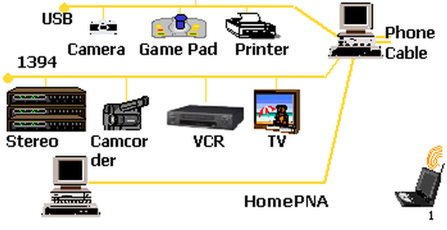
Types of Network
PAN (Personal Area Network)
Network which is used for connecting the computer devices of personal use is known as Personal Area Network.
Personal computer devices that are used to develop the personal area network are the laptop, mobile phones, media player and play stations.
PAN is the most basic type of computer network. This network is restrained to a single person, that is, communication between the computer devices is centered only to an individual’s work space.
PAN offers a network range of 5 to 10 meters from a person to the device providing communication.
Src: https://brainly.in

Slide 22
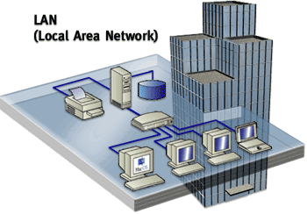
Types of Network
LAN (Local Area Network)
LAN is a group of computers connected to each other in a small area such as building, office.
LAN is used for connecting two or more personal computers through a communication medium such as twisted pair, coaxial cable, etc.
The basic idea of LAN is to provide easy access to Data Terminal Equipment with in the office.
A LAN is a system composed of computer hardware and transmission media and software.
Using LAN not only computer but access printer, plotter, database server etc..
Src: https://pnuedtechstudents.weebly.com/lan-local-area-network.html

Slide 23
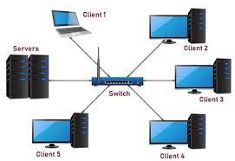
Types of Network
LAN (Local Area Network)
The LAN is used as private network, so organization can add one or more facility.
The range of LAN is maximum 5 Kms to 10 Kms.
LAN characteristics:
Personal computers, printers, etc., are connected through LAN.
LANs are very easy to design and troubleshoot.
A central database is used to connect the LAN networks.
The data transfer rate of LAN is 10 Gbits/s.
LANs are limited to local areas.

Slide 24
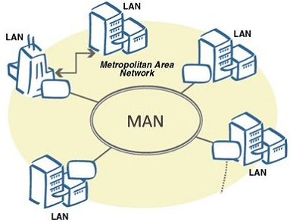
Types of Network
MAN (Metropolitan Area Network)
A metropolitan area network (MAN) is a computer network that interconnects with computer in a metropolitan area like city.
MAN is a larger than LAN but smaller than the area covered by a WAN. It is also used to interconnection of several local area network.
A MAN is limited to city or group of nearby corporate offices. Range of MAN is 10 km to 100 km.
MAN is designed with two unidirectional buses. Each bus is independent of the other in the transfer of traffic.
MANs are based on fiber-optic transmission technology an provide high speed interconnection between sites.
It can support both data and voice. IEEE standard of MAN is 802.6.

Slide 25
Types of Network
MAN (Metropolitan Area Network)
MAN characteristics:
The geographical area covered is larger than LAN.
Range of MAN is 10 km to 100 km.
The television network is the prime example of MAN.

Slide 26
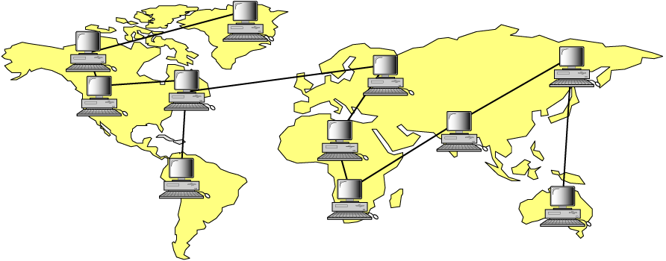
Types of Network
WAN (Wide Area Network)
A network that covers a larger area such as a city, state, country or the world is called Wide Area Network.
A wide area network (WAN) is a computer network that exists over a large-scale geographical area.
A WAN connects different networks, including local area networks (LAN) and metropolitan area networks (MAN).
Asia
America
Africa

Slide 27
Types of Network
WAN (Wide Area Network)
In the WAN, when the packet is sent from one router to another via one or more intermediate routers, the packet is received at each intermediate router in its entirely.
WAN uses point-to-point, store and forward, or packet switched subnet.
WAN characteristics:
The largest area, like a country, is covered by WAN.
Different metropolitan countries are linked through the telecommunications network.
WAN may be interconnected in and around the world.
The connection between the networks is established through telephone lines or satellites.

Slide 28
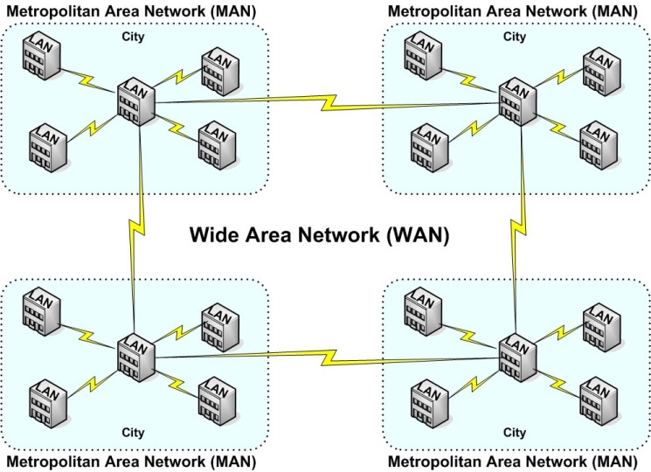
Types of Network
Summary of LAN MAN WAN

Slide 29

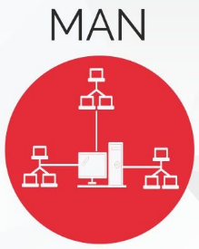
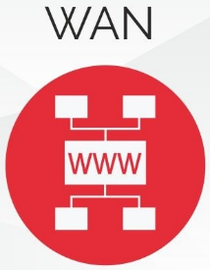
LANs, MANs and WANs
Full-form | Local Area Network | Metropolitan Area Network | Wide Area Network
Transmission speed | High comparatively | Average comparatively | Low comparatively
Propagation delay | Short | Moderate | High
Congestion | Low comparatively | Average comparatively | High comparatively
Maintenance | Easy | Difficult than LAN | Difficult than MAN and LAN
Scope | Small (1 to 10 Km) e.g. Small building, cluster of building, organization | Multiple Building or Society or in a city.(upto 100 Km area) | Multiple city or country (beyond 100Km)
Ownership | Private | Private or public | Private or public
Medium | Cable | Telephone lines | Telephone lines, satellite

Slide 30
Transmission Modes

Slide 31
Transmission Modes
Transmission means transferring of data between two devices.
The way in which data is transmitted from one device to another device is known as transmission modes.
It is also known as communication mode.
There are three types of transmission mode:-
Transmission
Modes
Simplex
Half Duplex
Full Duplex

Slide 32
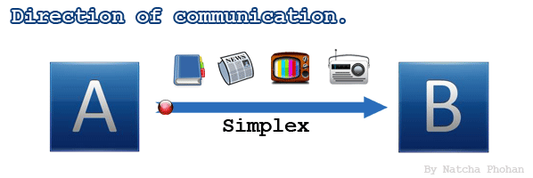
Transmission Modes
Simplex
In Simplex mode, the communication is unidirectional, like as one-way street.
Example: FM Radio, TV Broadcasting, Keyboard, Monitors.
Only one of the two devices on a link can transmit, the other can only receive.
The simplex mode can use the entire capacity of the channel to send data in one direction.

Slide 33
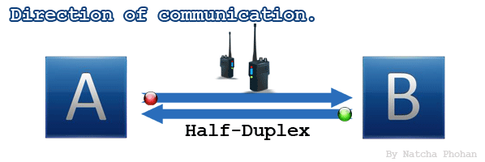
Transmission Modes
Half Duplex
In half-duplex mode, each station can both transmit and receive, but not at the same time.
Example: Walkie- talkie.
When one device is sending, the other can only receive, and vice versa.
The half-duplex mode is used in cases where there is no need for communication in both direction at the same time.
The entire capacity of the channel can be utilized for each direction.

Slide 34
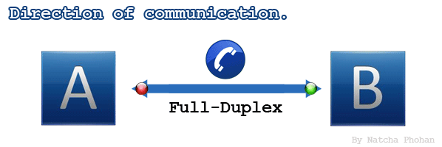
Transmission Modes
Full Duplex
In full-duplex mode, both stations can transmit and receive simultaneously.
Example: Telephone, Mobile Phones
In full duplex mode, sharing can occur in two ways:
Either the link must contain two physically separate transmission paths, one for sending and other for receiving.
Or the capacity is divided between signals travelling in both directions.
Full-duplex mode is used when communication in both direction is required all the time.

Slide 35
Comparison of Transmission Modes
Parameters | Simplex | Half Duplex | Full Duplex
Direction of communication | unidirectional | bidirectional, but one at a time. | bidirectional
Send / Receive | A device can either send or receive the data. | Both the devices can send and receive the data, but one at a time. | Both the devices can send and receive the data simultaneously.
Performance | Simplex mode performance is lower in compare to half and full duplex mode. | Half duplex mode performance is better than simplex but lower then full duplex mode. | The Full-duplex mode has better performance among simplex and half-duplex mode.
Bandwidth Utilization | Maximum | Maximum | Shared
Example | Radio, Television | Walkie-Talkies | Telephone Network, Mobile Phones

Slide 36
Understanding of Delay

Slide 37
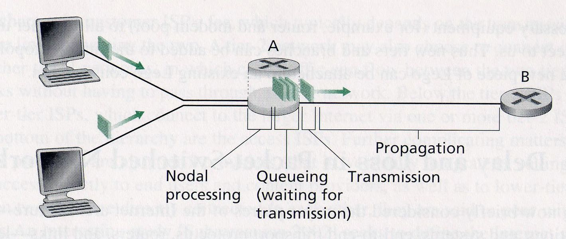
Understanding of Delay
A packet during its travel from one node to the subsequent node it suffers from different types of delay at each node.
All delays accumulated together and result in a larger delay called total nodal delay.
Types of
Delay
Queuing
Delay
Transmission
Delay
Propagation
Delay
Processing
Delay

Slide 38
Understanding of Delay
Processing Delay
Processing delay is a nodal delay and it is defined as the time required examining the packets header and determining where to direct the packet.
The processing delay is denoted by d_{proc}
Processing delay also include delay due to the time needed to check for bit-level errors in the packet that occurred in transmitting the packet’s bits from the upstream router to other router.

Slide 39
Understanding of Delay
Queuing Delay
The queuing delay is denoted d_{queue}
The queuing delay is observed at the queue, the packet experiences a queuing delay as it waits to be transmitted over the link.
The delay of a packet can vary from packet to packet. If the queue is empty and no other packet is currently being transmitted, then packet’s queuing delay zero.
When the traffic heavy and packets are waiting to be transmitted, the queuing delay will be high.

Slide 40
Understanding of Delay
Transmission Delay
The transmission delay is defined as the amount of time required to transmit all of the packet bits over the link.
The transmission delay is denoted by d_{trans}
The transmission delay is also called as store-and forward delay.
It is ration packet length(bits) to transmission rate (bits/sec).
Transmission delay = Packet length / Transmission rate = L/R

Slide 41
Understanding of Delay
Propagation Delay
The propagation delay is defined as time required by a packet to propagate from transmitting node to the receiving node.
The propagation delay is denoted d_{prop}
The propagation speed of a packet depends on characteristic of physical medium of the link and the distance between the nodes.

Slide 42
Understanding of Delay
Total Nodal Delay
The total node delay experienced by a packet is sum of processing delay, queuing delay, transmission delay and propagation delay within a network.
The total delay is very significant parameter of a network.
Total nodal delay = d_{proc} + d_{queue} + d_{trans} + d_{prop}

Slide 43
Throughput & Loss
Throughput
In data transmission, network throughput is the amount of data moved successfully from one place to another in a given time period, and typically measured in bits per second (bps), as in megabits per second (Mbps) or gigabits per second (Gbps).
Packet Loss
Packet loss occurs when one or more data packets travelling across a computer network fail to reach their destination.
Packet loss is typically caused by network congestion.
Packet loss is measured as a percentage of packets lost with respect to packets sent.

Slide 44
Network Topology

Slide 45
Network Topology
Physical or Logical layout of structure called topology, in which all nodes are connected.
Network topology is the arrangement of the elements of a communication network.
The physical topology of LAN refers to the way in which the stations are physically interconnected.
Feature of network topology:
The topology should be flexible. You can increase or decrease number of nodes in topology.
The cost of physical media and installation should be minimum.
The network should not have any single point of complete failures.
Each topology has its own strengths and weakness.

Slide 46
Network Topology
Types of topology
Types of
Topology
Bus Topology
Star Topology
Ring Topology
Mesh Topology
Hybrid Topology

Slide 47
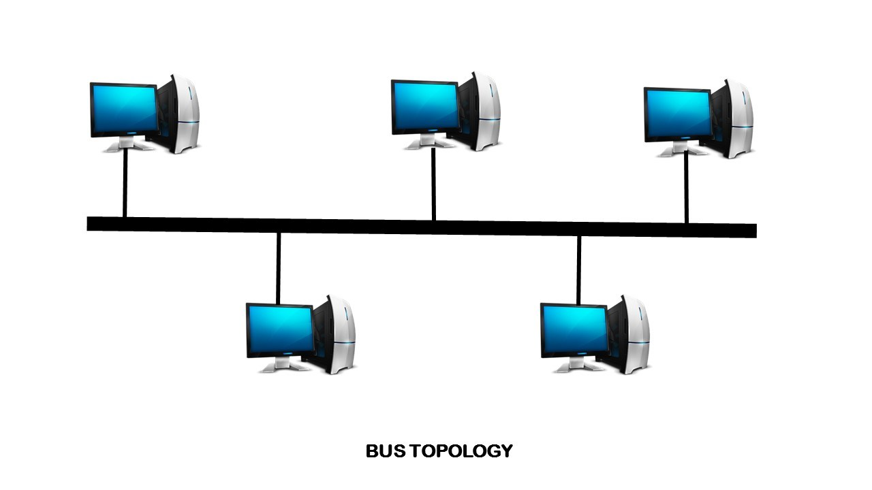
Bus Topology
A bus topology is a network setup in which each computer and network device are connected to a single cable or backbone.
The cable to which the nodes connect is called a "backbone".
When one computer sends a signal up (and down) in the cable, all the computers on network receive the information, but only one accepts the information (using address matching). The rest discard the message.

Slide 48
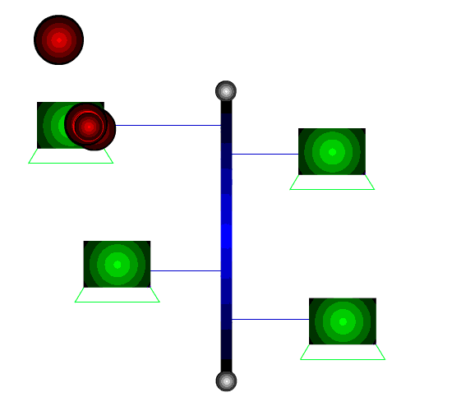
Bus Topology
Bus is passive topology because it requires termination. Cable cannot be left unterminated in a bus network.
Terminators were connected to each end of cable.
A host on a bus network is called a Station or workstation.

Slide 49
Bus Topology
Advantages:
Easy to use and easy to install.
A repeater can also be used to extend a bus topology.
Low cost.
Disadvantages:
Heavy network traffic can slow a bus network.
It is difficult to troubleshoot a bus topology.
Failure of backbone cable, all stations have been disconnected.
Difficult to add new node.

Slide 50
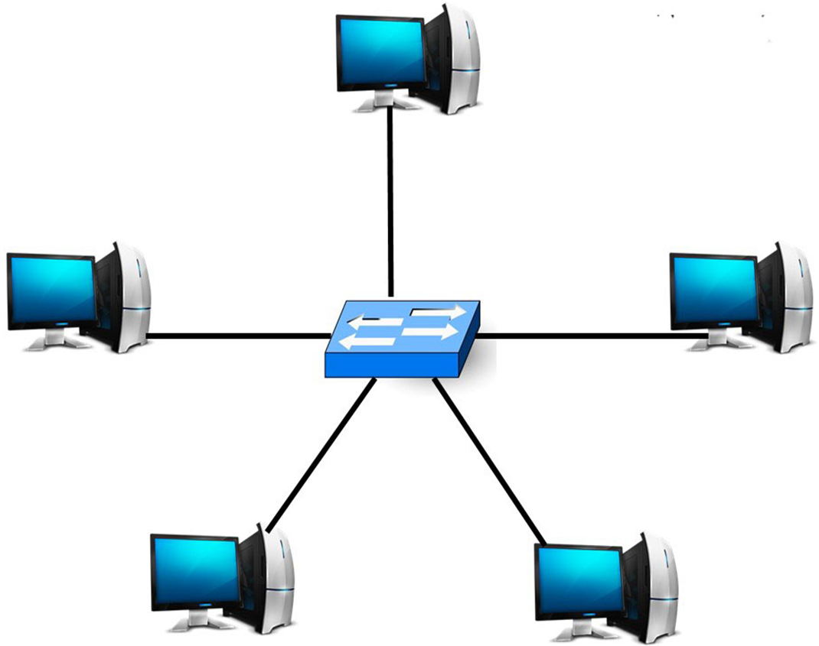
Star Topology
A star topology, sometimes known as a star network. It is a network topology in which each device is connected to a central hub.
In this network arrangement, all devices linked to a central network device are displayed as a star.
Easy to control and traffic flow is simple. Data travels from the sender to central hub and then to the receiver.
A dedicated link is provided to host and centralize hub. Centralized device may be hub or switch.

Slide 51
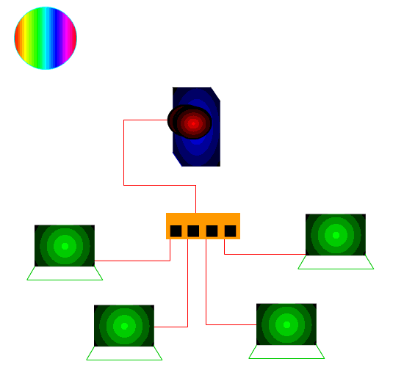
Star Topology
This image is an example of star topology that will help you to make understand clearly about star topology.
You can see Hub is a central device through which all other nodes (Clients, Servers, and other Networks) are connected.
Each node in this diagram has a direct point-to-point link to the central device, yet no single node can communicate directly with the others.
Therefore, before reaching the destination, each message has to pass through this central device (Hub or Switch).

Slide 52
Star Topology
Advantages:
It is easy to modify and new nodes to a star network without disturbing the rest of the network.
Troubleshooting techniques are easy.
Failures of any node do not bring down the whole star network.
Disadvantages:
If the central hub fails, the whole network fails to operate.
Each device requires its own cable segment.
Installation can be moderately difficult, especially in the hierarchical network.

Slide 53
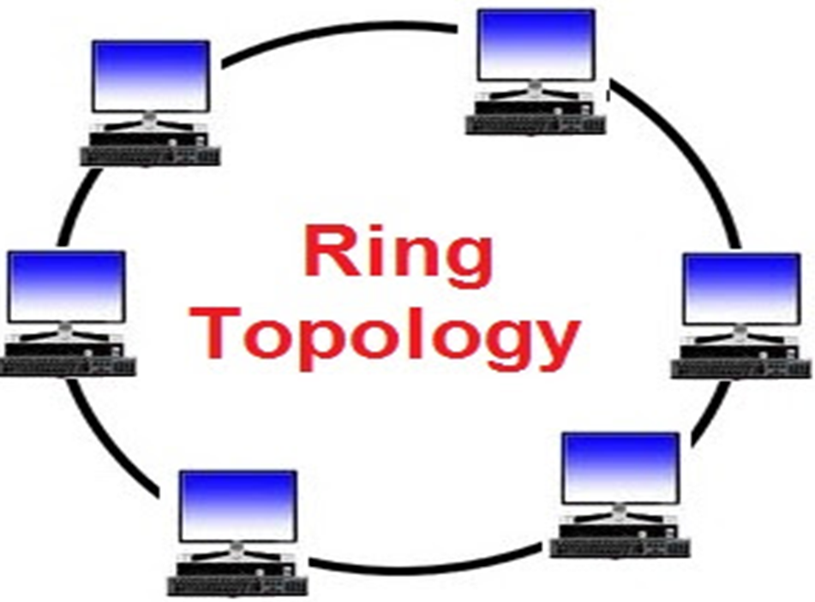
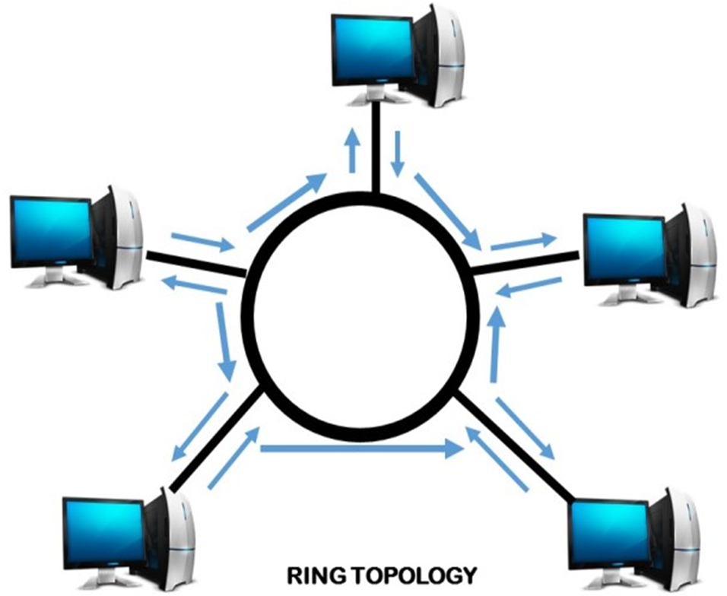
Ring Topology
A ring topology is a network architecture in which devices are connected in a ring structure and send information to each other based on their ring node's neighbouring node.
In a ring topology, each computer is connected to the next computer, with the last one connected to the first.
The signal travel on the cable in only one direction. Since each computer retransmits what it receives.
Ring is an active network. Termination is not required.

Slide 54
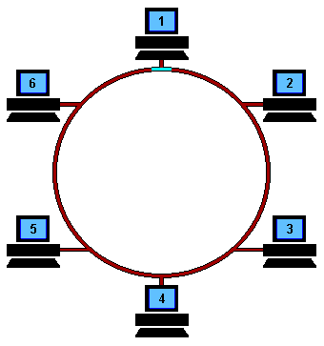
Ring Topology
Working of Ring Topology
A free token is circulating on the ring. If any host want to send data it has to first capture token which is circulating in ring.
Then writes data and recipient address on the token.
The token send to the next host, who read the address, if address in not own then pass to the next host.
This process is continue until the token received by destination.

Slide 55
Ring Topology
Working of Ring Topology
Destination host send acknowledgement with the help of token, and send to the source host.
When acknowledge received by source and then token is free. Token is again circulating in ring network.

Slide 56
Ring Topology
Advantages:
Cable failures are easily found.
Because every node is given equal access to the token.
Data transfer speed is high.
Disadvantages:
Adding and removing nodes disrupts the network.
It is difficult to troubleshoot a ring network.
Failure of one node can affect the whole network.
Cost of cable is more in ring network.

Slide 57
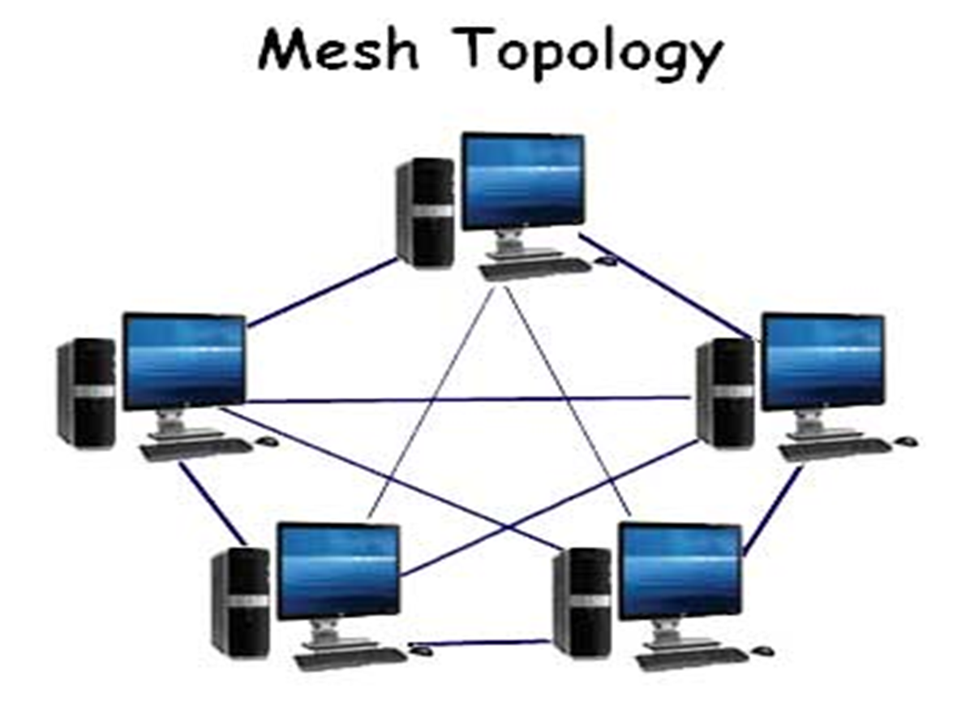
Mesh Topology
The mesh topology has a link between each device in the network.
It is more difficult to install as the number of devices increase. Mesh network are easy to troubleshoot.
Much of the bandwidth available in mesh configuration is wasted.
Most mesh topology networks are not true mesh.
Rather they are hybrid mesh networks, which contain some most important sites with multiple links.

Slide 58
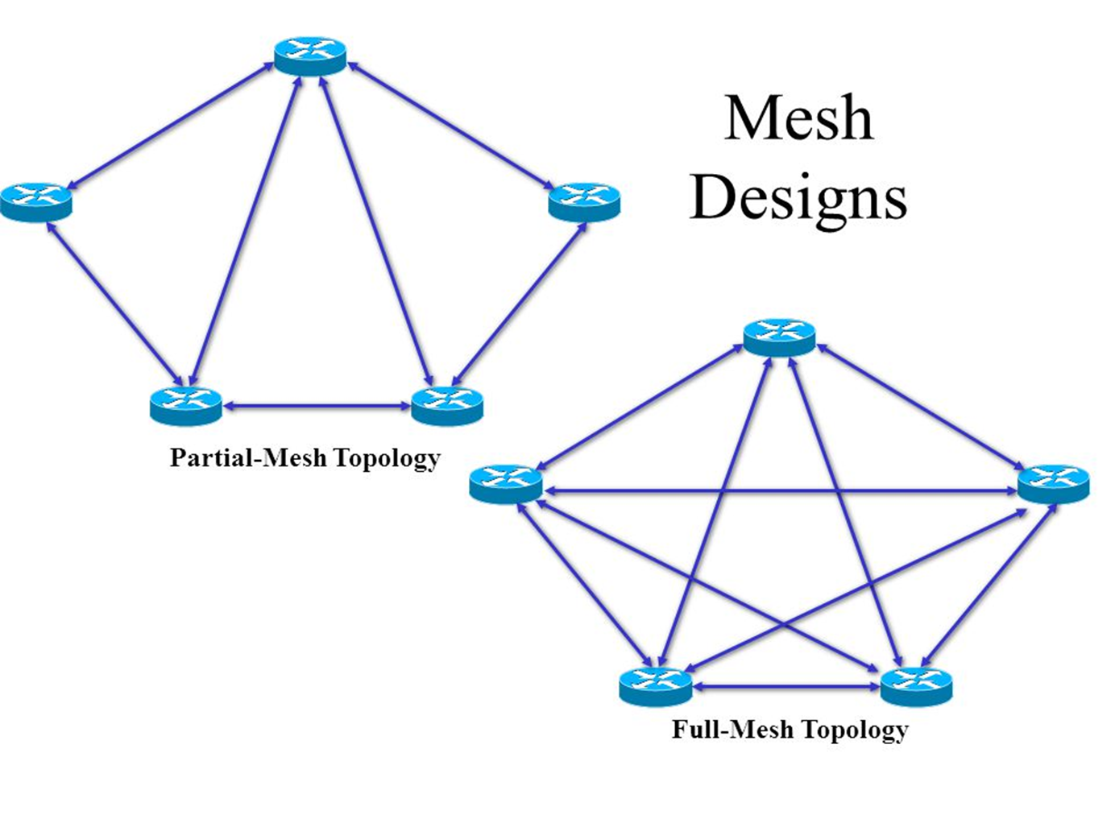
Mesh Topology
Mesh topology is divided into two categories:
Fully connected mesh topology
Partially connected mesh topology

Slide 59
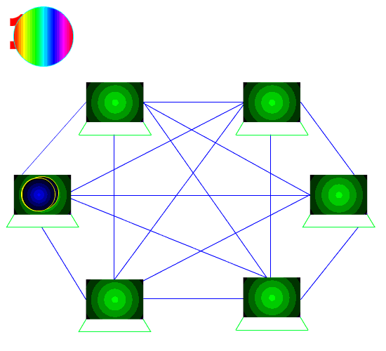
Mesh Topology
Fully Mesh Topology
In a full mesh topology, every computer in the network has a connection to each of the other computers in that network.
The number of connections in this network can be calculated using the following formula (n is the number of computers in the network): n*(n-1)/2
A mesh topology is a network topology in which all the network nodes are individually connected to most of the other nodes. There is not a concept of a central switch, hub or computer.
Most mesh topology networks are not true mesh.

Slide 60
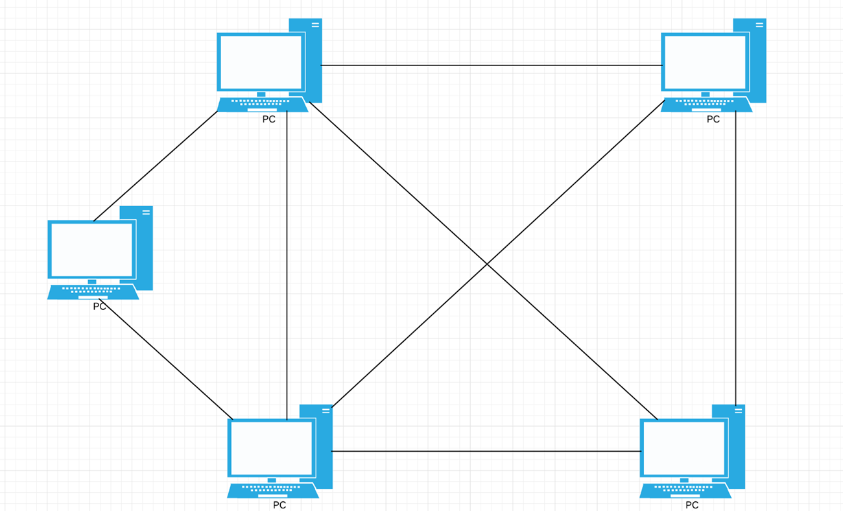
Mesh Topology
Partially Mesh Topology
In a partially connected mesh topology, at least one/two of the computers in the network have connections to multiple other computers in that network.
It is less expensive in compare to fully connected mesh and also implement redundancy in a network.
In the event that one of the primary computers or connections in the network fails, the rest of the network continues to operate normally.
Also there is no any central device like hub/switch in partially connected mesh topology.

Slide 61
Mesh Topology
Advantages:
A fault is diagnosed easily
Failure link cannot stop data transmission from sender to receiver.
Data transmission speed is too high.
Disadvantages:
Building and maintaining the topology is difficult and time consuming.
Cost of very high in compare to other topologies.
More difficult to install as the number of devices increase.
Most of bandwidth are wasted.

Slide 62
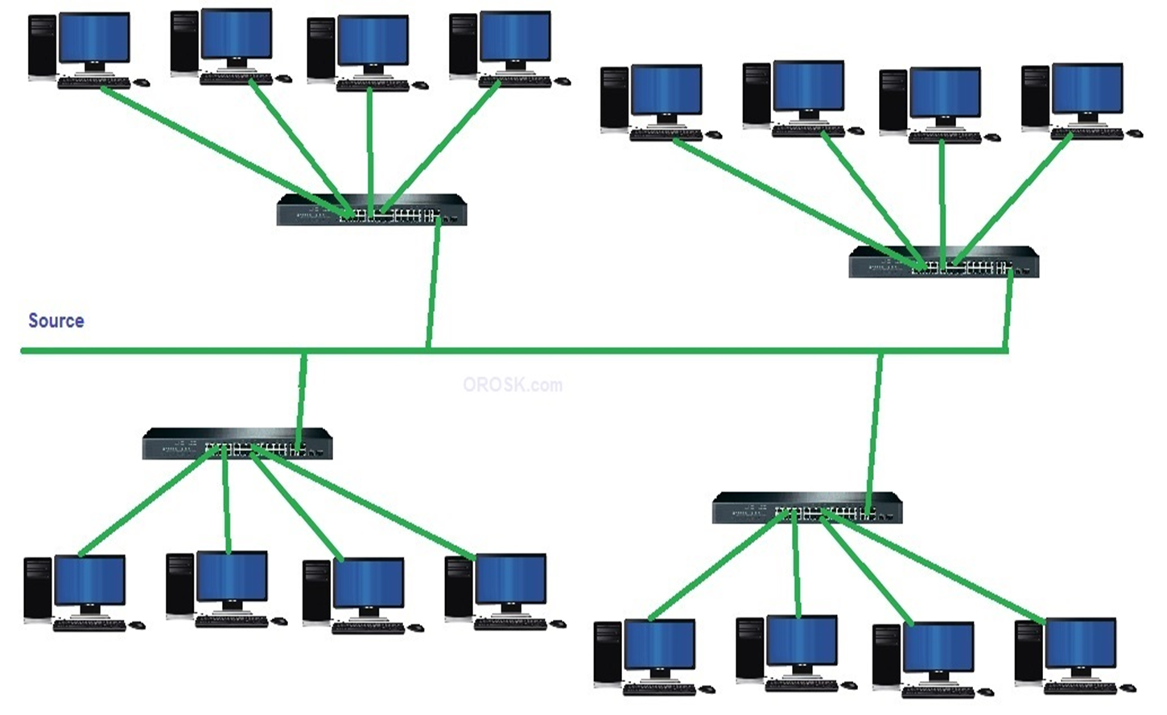
Hybrid Topology
A hybrid topology is a combination of two or more topologies.
Tree topology is also called hybrid topology. Tree topology combination of bus & star topology network.
Tree topologies allow for the expansion of an existing network.
Mostly used when flexibility is needed in existing network.
Combination of ring & star are hybrid topology but not tree topology.

Slide 63
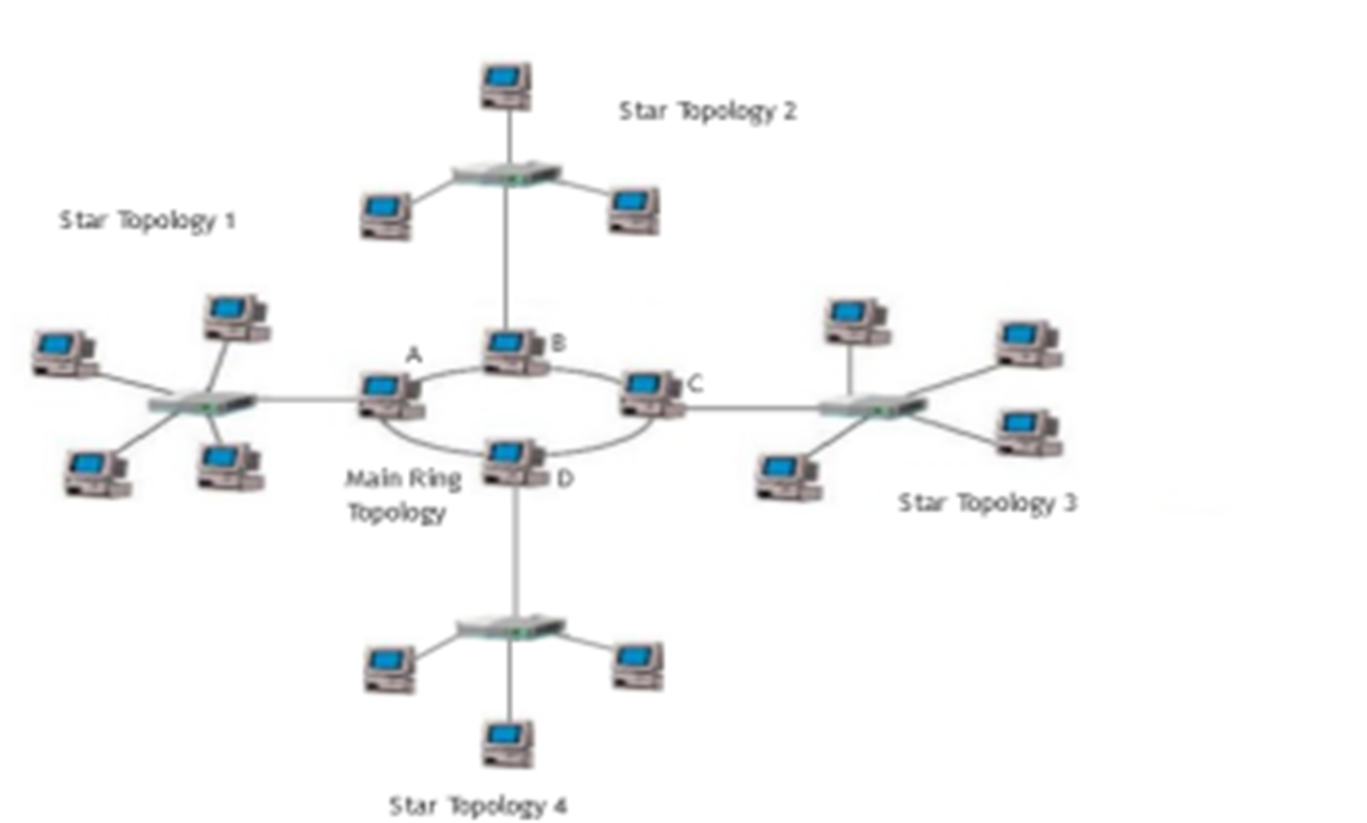
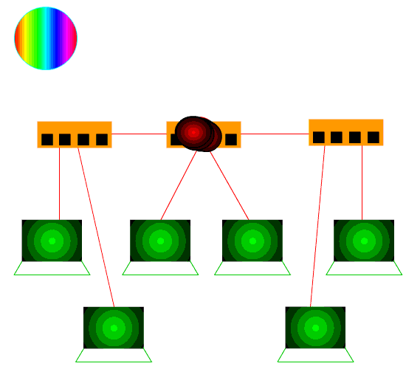
Hybrid Topology

Slide 64
Hybrid Topology
Advantages:
Expansion of Network is possible and easy.
Error detection and correction is easy.
If one segment is damaged, other segments are not affected.
Provides flexibility in network
Disadvantages:
Overall length of each segment is limited by the type of cabling used.
If the backbone line breaks, the entire segment goes down.
More difficult to configure and wire than other topologies.

Slide 65
OSI Model (Layered Approach)

Slide 66
OSI Model
OSI Model developed by ISO (International Organizations for Standardization)
OSI stands for Open System Interconnection. There are seven layer in this model.
Physical Layer
Data Link Layer
Network Layer
Transport Layer
Session Layer
Presentation Layer
Application Layer
OSI model provides following services:
Provides peer-to-peer logical services with layer physical implementation.
Provides standards for communication between system.
Define point of interconnection for the exchange of information between system.
Each layer should perform a well defined function.
A - Application Layer
P - Presentation Layer
S - Session Layer
T - Transport Layer
N - Network Layer
D - Data Link Layer
P - Physical Layer
Please Do Not Tell Secret Password Anyone

Slide 67
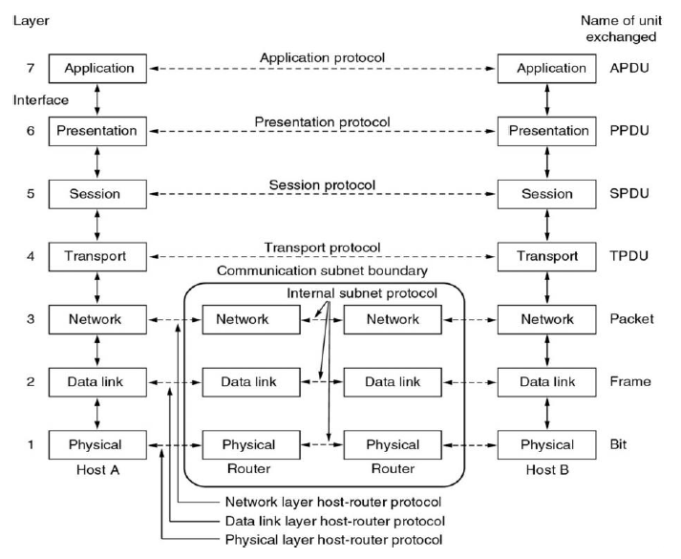
OSI Model

Slide 68
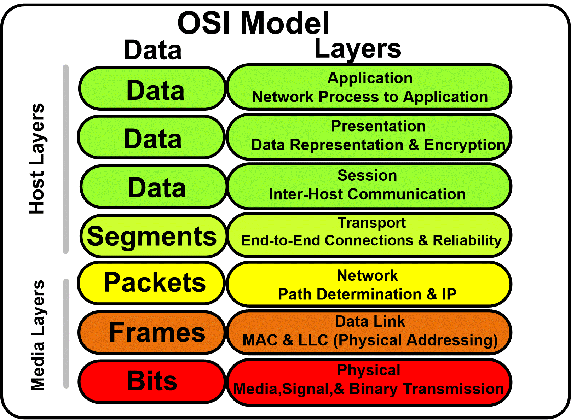
Application Layer
The application layer is responsible for providing services to the user.
It provides user interfaces and other supporting services such as e-mail, remote file access, file transfer, sharing database etc...
Protocols: HTTP, HTTPS, FTP, SMTP
Functionality
Network virtual terminal: It is a software version of physical terminal that allows a user to log onto a remote host.
File Transfer, Access and Management (FTAM): FTAM allows user to access files and remote hosts, to retrieve files and to manage files in remote computer.
Mail Services: E-mail forwarding, storage are the services under this category.

Slide 69
Presentation Layer
This layer is concerned for data representation.
The presentation layer deals with syntax and semantics of the information being exchanged.
The presentation layer is responsible for translation, compression, and encryption.
Functionality:
Translation: Different computers use different encoding systems. The presentation layer maintains interoperability between the two encoding system.
Encryption: Encryption is transforming sender information to non-readable format while transmission. Decryption is reverse process.
Compression: Compression is a technique of reducing number of bits required to represent the data.

Slide 70
Session Layer
The session layer is responsible for dialog control and synchronization.
This layer is network dialog controller – establishes, maintains, synchronizes the interaction among computers.
Functionality:
Dialog Control: Communication between two process take place in either half duplex or full-duplex mode. The session layer manages dialog control for this communication.
Synchronization: Session layer adds synchronization points into stream of data.

Slide 71
Transport Layer
The transport layer is responsible for the delivery of a message from one process to another.
Transport layer ensures that the whole message arrives intact and in order with error control and process control.
Data in the transport layer is known as segments.
Functionality:
Port addressing: Computer performs several operations simultaneously. Process-to-process delivery means specific process of one computer must be delivered to specific process on other computer. The transport layer header therefore include port address.

Slide 72
Transport Layer
Functionality:
Segmentation and reassembly: A message is divided into a segments, each segment contains a sequence number which enables transport layer to reassemble at destination.
Connection Control: Transport layer performs connectionless or connection oriented services with the destination machine.
Flow Control: Transport layer performs end-to-end flow control while data link layer performs it across the link.
Error Control: Error control at this layer is performed on end-to-end basis rather than across the link. The transport layer ensures error free transmission.

Slide 73
Network Layer
The network layer is responsible for the delivery of packets from the source to destination.
Network layer provides host to host delivery. Data in the network layer is known as packets.
Functionality:
Logical Addressing: DLL implements physical addressing. When a packet passes network boundary. An addressing system is needed to distinguish source and destination, network layer performs these function. The network layer adds a header to the packet of upper layer includes the logical addresses of sender and receiver.
Routing: Network layer route or switch the packets to its final destination in an internetwork.

Slide 74
Data Link Layer
The data link layer is responsible for transmitting frames from one node to the next.
It transforms the physical layer to a reliable link making it an error free link to upper layer.
Data link layer is divided into two sub layers:
LLC (Logical Link Control - Upper Layer)
MAC (Media Access Control - Lower Layer)
LLC is responsible for Flow control, Error Control, Access Control.
MAC is responsible for Physical addressing.

Slide 75
Data Link Layer
Functionality:
Framing: The frames received from network layer is divided into manageable data units called frames.
Physical Addressing: When frames are to be sent to different LANs, the data link layer adds a header to the frame to define sender to receiver.
Flow Control: When the rate of the data transmitted and rate of data reception by receiver is not same, some data may be lost. So, this layer manages data flow.
Error Control: Data link layer incorporates reliability to the physical layer by adding mechanism to detect and retransmit damaged or lost frames.
Access Control: When multiple devices are connected to same link, the data link layer determines which device has control over link.

Slide 76
Physical Layer
Physical layer is the lowest layer of the OSI model.
The physical layer is responsible for transmit individual bits from one hop (node) to the next.
Carries the bit stream over a physical media.
Physical layer co-ordinates the function required to transmit a bit stream over a communication channel.
It deals with electrical and mechanical specifications of interface and transmission media.

Slide 77
Physical Layer
Functionality:
Representation of bits: Physical layer encodes the bit stream into electrical or optical signal.
Data rate: The physical layer defines the duration of a bit which is called as data rate or transmission rate.
Synchronization of bits: The transmission rate and receiving rate must be same. This is done by synchronizing clocks at sender and receiver.

Slide 78
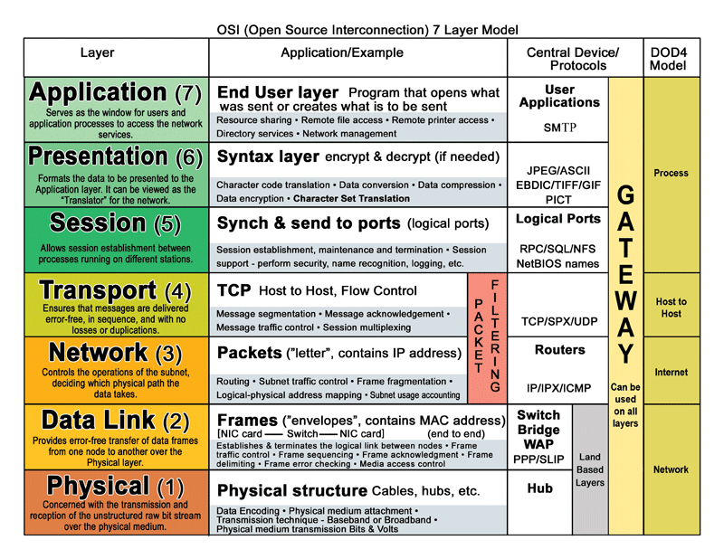
Summary of OSI Reference Model

Slide 79
TCP/IP Model

Slide 80
TCP/IP Model
The internet architecture, which is also sometimes called the TCP/IP architecture because of its two main protocols.
It stands for Transmission Control Protocol/Internet Protocol.
TCP/IP was designed and developed by the Department of Defense (DoD) in the 1960s and is based on standard protocols.
TCP/IP is four layer system.
Application layer
Transport layer
Internet layer
Host to network layer (Link Layer/Network Interface)

Slide 81
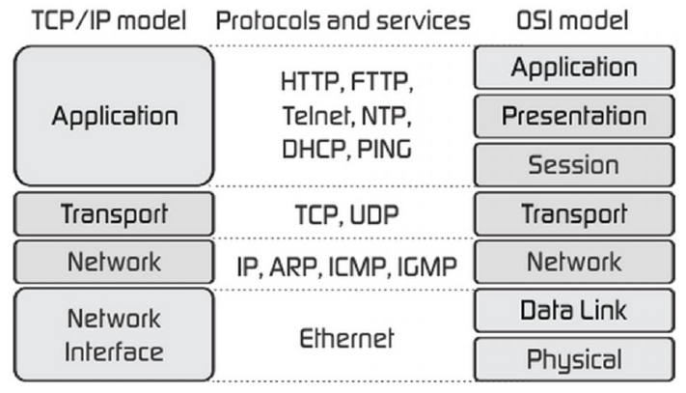
TCP/IP Model
Host to network interface layer is called as physical and data-link layer in OSI model.
Internet layer is called network layer in OSI model.
The application layer in TCP/IP model is combination of application, presentation and session layer of OSI model.

Slide 82
Application Layer
Application layer includes all process and services that use transport layer to deliver data.
The most widely known application protocols are: TELNET, File Transfer Protocol (FTP), Simple Mail Transfer Protocol (SMTP) and Simple Network Management Protocol (SNMP).
TELNET is the Network Terminal Protocol, which provides remote login over the network.
FTP is used for interactive file transfer.
SMTP delivers the electronic mail.
Notes:
TELNET---
Telnet (short for "teletype network") is a client/server application protocol that provides access to virtual terminals of remote systems on local area networks or the Internet.

Slide 83
Transport Layer
Application program sends data to the transport layer protocols TCP and UDP.
An application is designed to choose either TCP or UDP based in the service it needs.
Transport layer provides process to process delivery in the network.
TCP is reliable and connection oriented protocol. It delivers data without error from one PC to another PC.
It converts incoming bytes into discrete message. At the receiver side TCP reassembles the received data or massage into bytes format.
TCP also handles flow control.
UDP is a connection less protocol. Sometimes this type of protocol is used for fast delivery. UDP cannot handle flow control or error checking.

Slide 84
Internet Layer
The internet layer protocol (IP, ARP, ICMP) handle machine to machine communication.
This layer protocols moves data from one host to another; even if the host are on different networks.
The primary protocol used to move data is the Internet protocol (IP), which provides the following service.
Addressing: Determining the route to deliver data to the destination host.
It provides connection less method of delivering data from one host to another.
It does not guarantee delivery and does not provide sequencing of datagram.
It attaches a header to datagram that includes source address and the destination address, both are unique internet addresses.
Notes:
The Internet Control Message Protocol (ICMP) is a protocol that devices within a network use to communicate problems with data transmission.

Slide 85
Host to network Layer
This layer is also called as link layer or network interface layer.
This layer is same as physical and data link layer of OSI model.
Host to Network layer cannot define any protocol.
It is responsible for accepting and transmitting IP datagram.
It transmits individual bits from one hop (node) to the next. Carries the bit stream over a physical media.

Slide 86
Difference between OSI and TCP/IP Model
Parameters | OSI Model | TCP/IP Model
No. of Layers | There are 7 layers. | There are 4 layers.
Acronyms | OSI stands for open system interconnection. | TCP/IP stands for transmission control protocol/internet protocol
Developed by | ISO | Department of Defense (DoD)
Layer Separation | OSI model has a separate Presentation layer and Session layer. | TCP/IP does not have a separate Presentation layer or Session layer.
Protocol implementation | Model was defined before implementation takes place. | Model defines after protocol were implemented.
Model Concept | based on three concept i.e. Service, interface and protocol. | It did not distinguish between service, interface and protocol.
Reliable delivery | It gives guarantee of reliable delivery of packet. | It does not give guarantee of reliable delivery of packet.

Slide 87
Switching Techniques

Slide 88
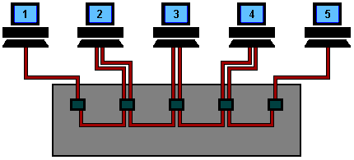
Switching Techniques
For transmission of data beyond a local area, communication is typically achieved by transmitting data from source to destination through a network of intermediate switching nodes.
Purpose is to provide a switching facility that will move the data from node to node until they reach their destination.
The nodes are connected to each other in some topology by transmission links.
Each station attaches to a node, and the collection of nodes is referred to as a communication network.
Two types of Switching Techniques:
Circuit Switching
Packet Switching
Notes:
In computer networking, Switching is the process of transferring data packets from one device to another in a network, or from one network to another, using specific devices called switches.

Slide 89
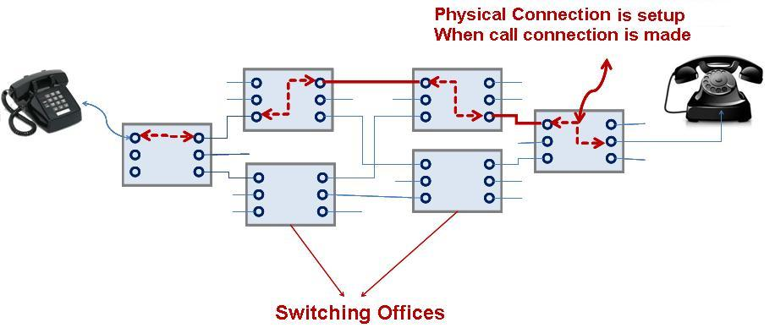
Circuit Switching
The telephone system as it historically developed was designed for voice and analog signals.
For voice signals, a relatively large amount of distortion is acceptable, since the human error can understand voice even with distortion .
For analog signals, these distortions may cause the receiver to misinterpret that signal, it produce errors.

Slide 90
Circuit Switching
Any phone line can connect one user to another through the phone system, the user has a line assigned randomly.
This is called the dial-up or switched network.
Telephone networks are connection oriented because they require the setting up of connection before the actual transfer of information can take place.
An end-to-end path setup beginning of a session, dedicated to the application, and then released at the end of session. This is called circuit switching.

Slide 91
Circuit Switching
Advantages
Fixed bandwidth and guaranteed capacity.
Low variance end to end delay.
Disadvantages
Connection setup and termination generate extra traffic.
User pay for circuit, even when not sending data.
Other user cannot use circuit even if it is free.

Slide 92
Packet Switching
In packet switching, messages are broken into short blocks and interleaved with other messages.
Data is sent in individual packets. Each packet is forwarded from switch to switch, eventually reaching its destination.
Each switching node has a small amount of buffer space to temporarily hold packets.
If the outgoing line is busy, the packet stay in queue until the line becomes available.
Packet switching method uses two routing approaches:
Datagram
Virtual Circuit

Slide 93
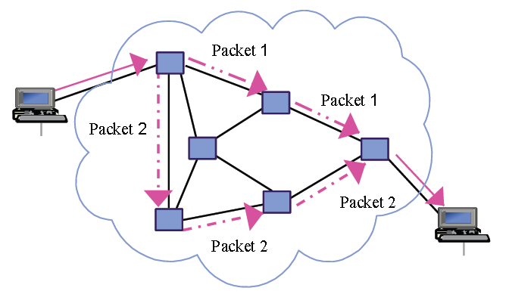
Packet Switching
Datagram
In datagram each packet is routed through independently through the network.
Header attached to each packet. It provides all of the information required to route the packet to its destination.
While routing the packet, the destination address in the header are examined to determine the next hop in the path to the destination.
If the required line is busy then the packet placed in the queue until the line becomes free.
Packet share the transmission line with other packets.

Slide 94
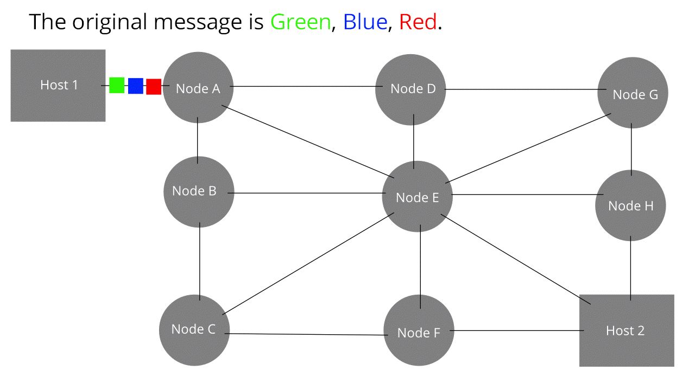
Packet Switching

Slide 95
Packet Switching
Advantages
Each packet travel through different path.
No need to establish connection process.
If any route will be down during data transmission, but packet reached at destination any way..
Data transmission speed is too high.
Disadvantages
Sequencing process must be done at sender side.
Packet may not arrive in order at destination in which they were sent.
Re-sequencing process is required at destination.
No dedicated path available, so there may be some delay during transmission.

Slide 96
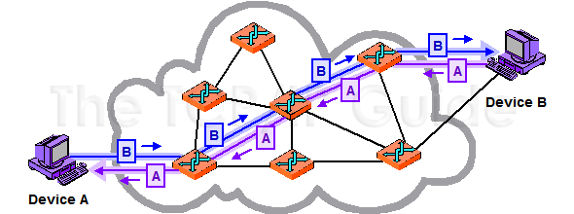
Packet Switching
Virtual Circuit
In virtual circuit packet switching a dedicated path must be established between a source and a destination before data transmission process.
Virtual circuit is also known as connection oriented network. It is similar to telephone system.
A route, which consists of a logical connection is first established between two users.
The process is completed in three main phases:
Establishment
Data transfer
Connection release

Slide 97
Packet Switching
Virtual Circuit
Establishment: During this phase, the two users not only agree to setup a connection but also decide upon the QoS. After establishment packets transfer bidirectional.
Data Transfer: During this performs flow control and error control. The error control service ensures correct sequencing of packets. Flow control service control faster sender and slower receiver.
Connection Release: When the station wish to close down the virtual circuit, one station can terminate the connection with a clear request packet.

Slide 98
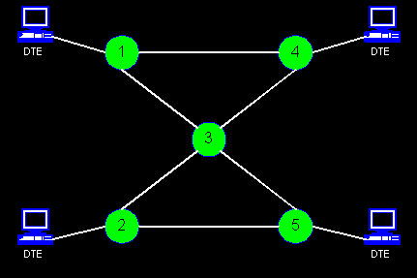
Packet Switching

Slide 99
Packet Switching
Advantages
Resource utilization more efficiently.
Small amount of time required to establish or terminate circuit.
It is more flexible.
Small size packet reduce transmission delay.
Disadvantages
Complex protocol for packet switching.
Algorithms are more complicated.
Switching processor must be powerful.
Packets may lost during switching.

Slide 100
Circuit Switching
Circuit Switching | Packet Switching
It is a connection oriented network switching technique. | It is a connectionless network switching technique.
Dedicated path has to be established between the source and the destination before transfer of data commences. | There is no need to establish a dedicated path from the source to the destination.
Data packets are routed along the same dedicated path. | Different data packets follow different paths.
Initially designed for voice transfer. | Initially designed for data transfer.
It is not a store and forward transmission. | It is store and forward transmission.
Data is processed and transmitted by the source station only. | Data is processed and transmitted, not only by the source station but at each switching station.
There are 3 phases in circuit switching i) Connection Establishment ii) Data Transfer iii) Connection Released | In Packet switching directly data transfer takes place.

Slide 101
Transmission Media

Slide 102
Transmission Media
A transmission medium is a physical path between the transmitter and the receiver i.e. it is the channel through which data is sent from one place to another.
The main functionality of the transmission media is to carry the information in the form of bits.
The characteristics and quality of data transmission are determined by the characteristics of medium and signal.
Different transmission media have different properties such as bandwidth, delay, cost and ease of installation and maintenance.
Transmission media is divided into two types: wired media and wireless media. In wired media, medium characteristics are more important whereas, in wireless media, signal characteristics are more important.

Slide 103
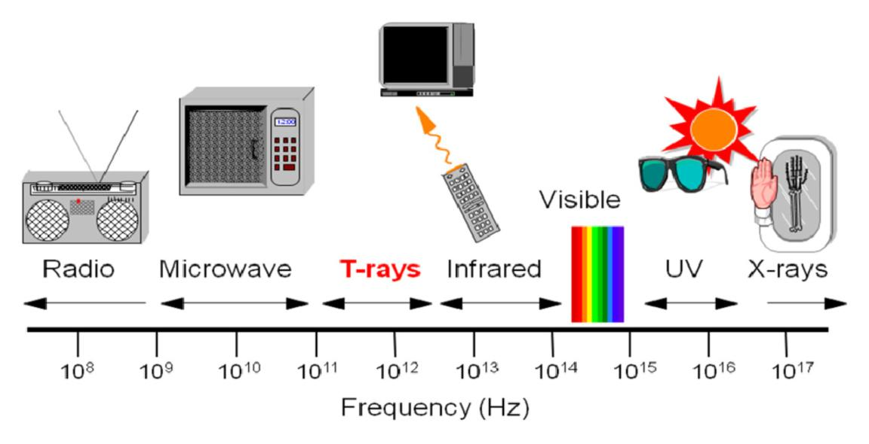
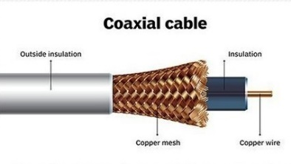
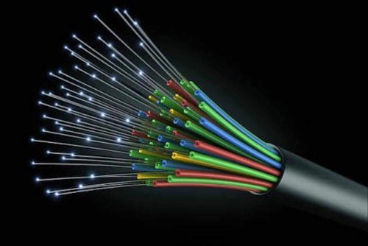
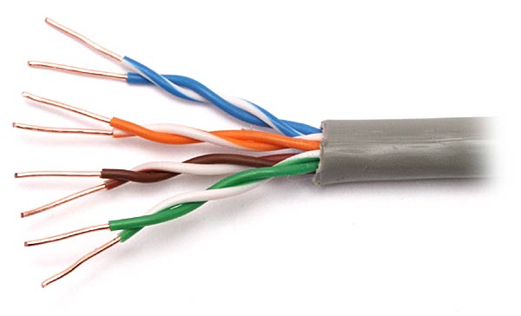
Classification of Transmission Media
Physical path between transmitter and receiver
Transmission Media
Waves are guided along a solid medium
Guided
Media
Unguided
Media
wireless transmission
Co-axial Cable
Fibre Optics
Twisted Pair
Radio waves
Micro waves
Infrared

Slide 104
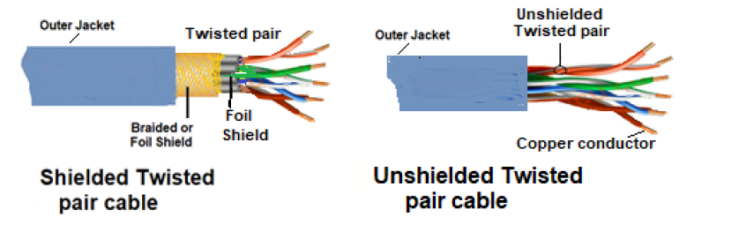
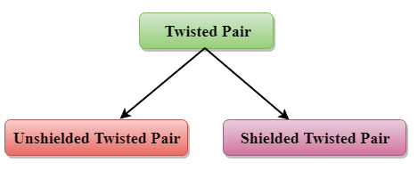
Guided Media
Twisted Pair:
Twisted pair is a physical media made up of a pair of cables twisted with each other.
A twisted pair cable is cheap as compared to other transmission media.
The frequency range for twisted pair cable is from 0 to 3.5KHz.

Slide 105
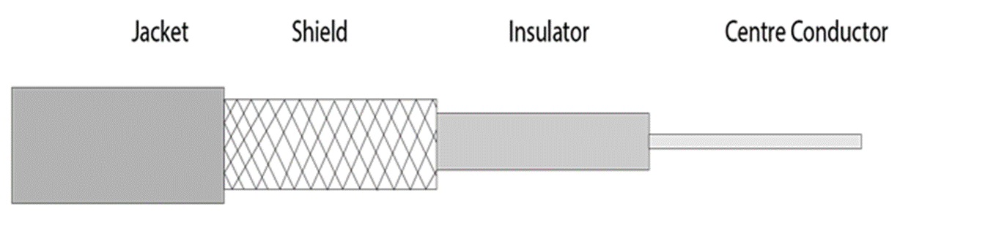
Guided Media
Co-axial Cable:
Coaxial cable is very commonly used in TV.
The inner conductor is made up of copper, and the outer conductor is made up of copper mesh. The middle core is made up of non-conductive cover
The middle core is responsible for the data transferring whereas the copper mesh prevents from the EMI(Electromagnetic interference).

Slide 106
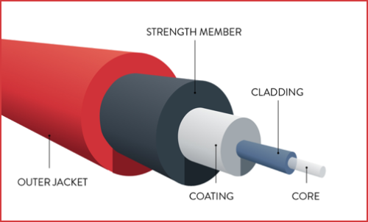
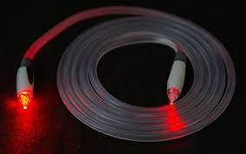
Guided Media
Fiber optic Cable:
It uses electrical signals for communication.
Fiber optic is a cable that holds the optical fibers coated in plastic that are used to send the data by pulses of light.
The plastic coating protects the optical fibers from heat, cold, electromagnetic interference from other types of wiring.
Fiber optics provide faster data transmission than copper wires.

Slide 107
Guided Media
Fiber optic Cable:
Core: The optical fiber consists of a narrow strand of glass or plastic known as a core. A core is a light transmission area of the fiber. The more the area of the core, the more light will be transmitted into the fiber.
Cladding: The concentric layer of glass is known as cladding. The main functionality of the cladding is to provide the lower refractive index at the core interface as to cause the reflection within the core so that the light waves are transmitted through the fiber.
Jacket: The protective coating consisting of plastic is known as a jacket. The main purpose of a jacket is to preserve the fiber strength, absorb shock and extra fiber protection.

Slide 108
Unguided Media
An unguided transmission transmits the electromagnetic waves without using any physical medium. Therefore it is also known as wireless transmission.
In unguided media, air is the media through which the electromagnetic energy can flow easily.
Unguided transmission is broadly classified into three categories: Radio wave, Micro wave, Infrared.

Slide 109
Unguided Media
Radio wave
Radio waves are the electromagnetic waves that are transmitted in all the directions of free space.
Radio waves are omnidirectional, i.e., the signals are propagated in all the directions.
In the case of radio waves, the sending and receiving antenna are not aligned, i.e., the wave sent by the sending antenna can be received by any receiving antenna.
An example of the radio wave is FM radio.

Slide 110

Unguided Media
Micro wave
Microwave is divided into two categories:

Slide 111
Unguided Media
Terrestrial Micro wave
Terrestrial Microwave transmission is a technology that transmits the focused beam of a radio signal from one ground-based microwave transmission antenna to another.
Microwaves are the electromagnetic waves having the frequency in the range from 1GHz to 1000 GHz.
Microwaves are unidirectional as the sending and receiving antenna is to be aligned, i.e., the waves sent by the sending antenna are narrowly focused.

Slide 112
Unguided Media
Satellite Micro wave
A satellite is a physical object that revolves around the earth at a known height.
Satellite communication is more reliable nowadays as it offers more flexibility than cable and fiber optic systems.
We can communicate with any point on the globe by using satellite communication.
How Does Satellite work?
The satellite accepts the signal that is transmitted from the earth station, and it amplifies the signal. The amplified signal is retransmitted to another earth station.

Slide 113
Unguided Media
Infrared
An infrared transmission is a wireless technology used for communication over short ranges.
The frequency of the infrared in the range from 300 GHz to 400 THz.
It is used for short-range communication such as data transfer between two cell phones, TV remote operation, data transfer between a computer and cell phone resides in the same closed area.
It supports high bandwidth, and hence the data rate will be very high.
Infrared waves cannot penetrate the walls.
Infrared communication is unreliable outside the building because the sun rays will interfere with the infrared waves.

Slide 114

General Frequency Ranges (Understanding Purpose)
VLF | Very Low Frequency | VHF | Very High Frequency
LF | Low Frequency | UHF | Ultra High Frequency
MF | Medium Frequency | SHF | Super High Frequency
HF | High Frequency | EHF | Extremely High Frequency
Frequency and wavelength are
inversely proportional to each other.
Notes:
Wavelength- The distance travelled by a wave in one complete oscillation is called as wavelength. The SI unit of wavelength is meter (m) and it is denoted by a Greek letter lambda (λ). Frequency- The number of oscillations completed in one second is called as frequency of a wave.
https://www.youtube.com/watch?v=9UPnWfBYf28

Slide 115

Thank
You

